Slide 1
Linear Regression
Boston University CS 506 - Lance Galletti

Slide 2
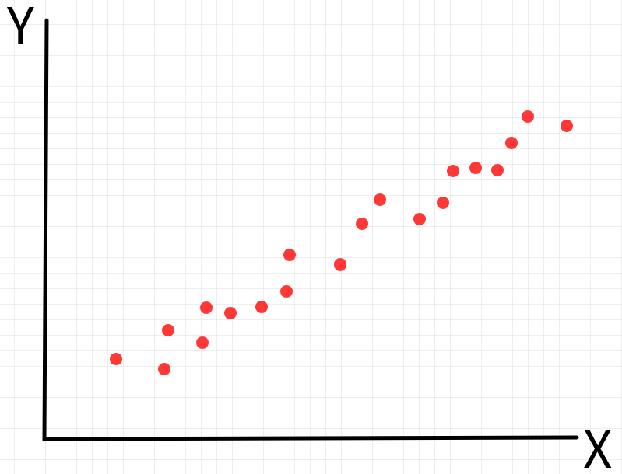
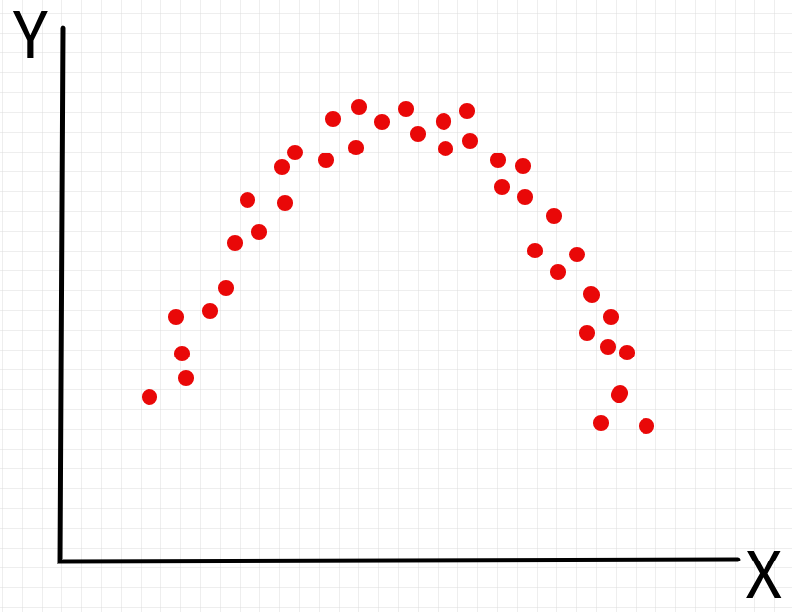
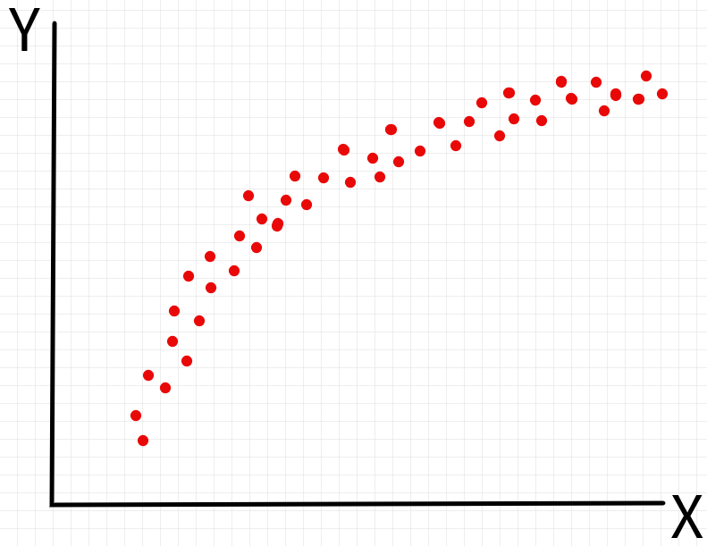
Motivation
Given n samples / data points (y_{i} , x_{i})

Slide 3
Motivation
Understand/explain how y varies as a function of x (i.e. find a function y = h(x) that best fits our data)

Slide 4
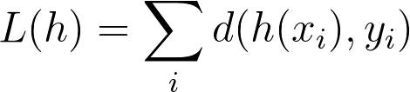
Motivation
Suppose we are given a curve y = h(x), how can we evaluate whether it is a good fit to our data?
Compare h(x_{i}) to y_{i} for all i.
Goal: For a given distance function d, find h where L is smallest.

Slide 5
Motivation
Should h be the curve that goes through the most samples? I.e. do we want h(x_{i}) = y_{i} for the maximum number of i?
h may be too complex
overfitting - may not perform well on unseen data

Slide 6
Motivation
The following curves seem the most intuitive “best fit” to our samples. How can we define this best fit mathematically? Is it just about finding the right distance function?

Slide 7
Motivation
Another way to define this problem is in terms of probability.
Define P(Y | h) as the probability of observing Y given that it was sampled from h.
Goal: Find h that maximizes the probability of having observed our data.

Slide 8
Motivation
To sum up we can either:
Minimize
Maximize
L(h) = P(Y | h)

Slide 9
Getting Started
Do we have enough to get started?
Seems like there are too many possible h and our problem statements are still too vague to effectively find solutions.
What can we do to constrain the problem?
Let’s make some assumptions!

Slide 10

Assumptions
Let’s start by assuming our data was generated by a linear function plus some noise:
Where h is linear in a parameter 𝜷.
Which functions below are linear in 𝜷?
h(x) = 𝜷₁x
✔
h(x) = 𝜷₀ + 𝜷₁x
✔
h(x) = 𝜷₀ + 𝜷₁x + 𝜷₂x²
✔
h(x) = 𝜷₁log(x) + 𝜷₂x²
✔
h(x) = 𝜷₀ + 𝜷₁x + 𝜷₁²x
✘

Slide 11
Assumptions
The relation between x (independent variable) and y (dependent variable) is linear in a parameter 𝜷.
ϵ_{i} are independent, identically distributed random variables following a N(0, σ²) distribution. (Note: σ is constant)

Slide 12
Assumptions
Y = X𝜷 + ϵ
ϵ_{i} ~ N(0, σ²)

Slide 13
Goal
Given these assumptions, let’s try to solve the max and min problems we defined earlier!
Q: What does solving these mean?
A: Finding 𝜷 is equivalent to finding h

Slide 14
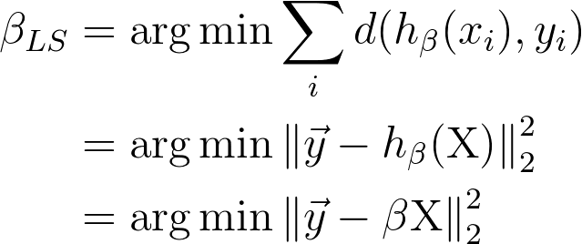
Least Squares
𝜷
𝜷
𝜷

Slide 15
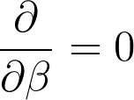
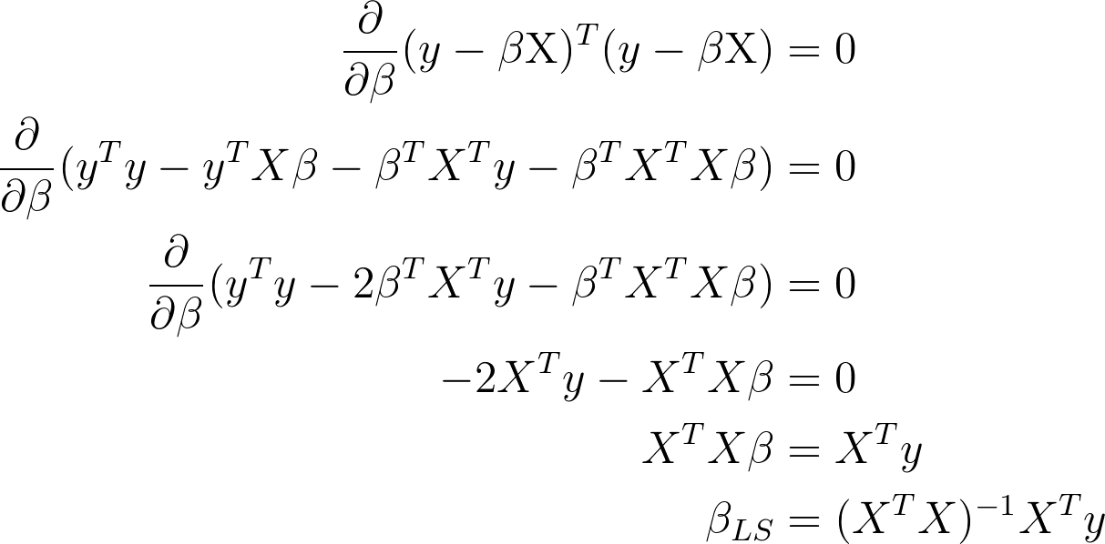
Least Squares

Slide 16
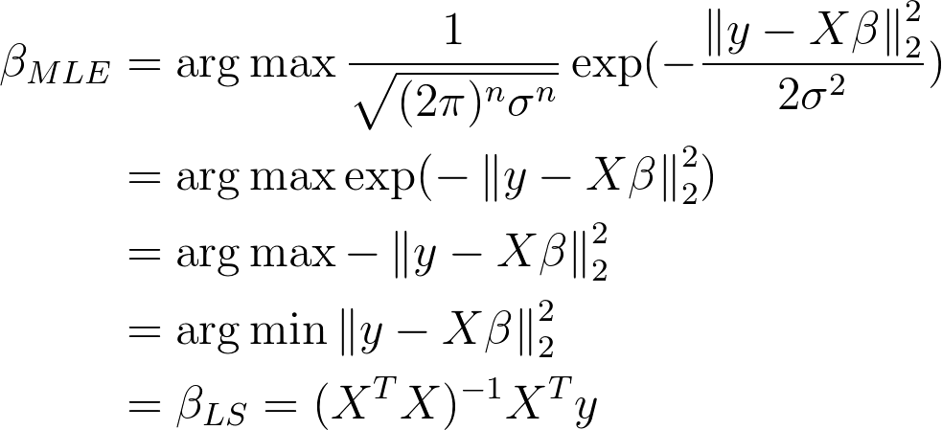
Maximum Likelihood
Since ϵ ~ N(0, σ²) and Y = X𝜷 + ϵ then Y ~ N(X𝜷, σ²).
𝜷
𝜷
𝜷
𝜷

Slide 17
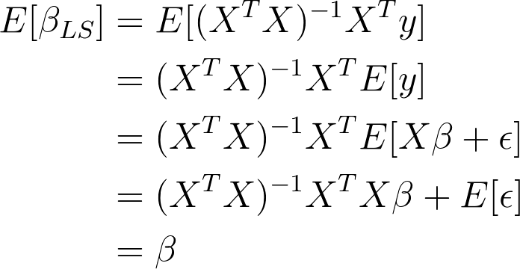
An Unbiased Estimator
𝜷_{LS} is an unbiased estimator of the true 𝜷. That is E[𝜷_{LS}]=𝜷.

Slide 18
Demo

Slide 19
Logistic Regression
So far y_{i} was a continuous variable. What if y_{i} is categorical?
Assume we have 2 classes.
Even if we can make these classes numerical (i.e. translate labels such as “yes”/”no” into 1 / 0), these numbers don’t have a mathematical meaning in the context of linear models and what we learn will be as arbitrary as the numerical labels we assigned (i.e. using “yes” =2/”no”=7 instead of “yes”=1/”no”=0 might “fit” a better model…).
Maybe we can use the probability of belonging to a given class as a proxy for how confidently we can classify a given point? Maybe we can fit a linear model to the probability of being in a given class!

Slide 20
Logistic Regression
So the output of our regression model could be a probability. But how can we enforce that X𝜷_{LS} from our model is always constrained to [0,1]? i.e. how can we learn a 𝜷_{LS} such that 0 ≤ X𝜷_{LS} ≤ 1 even for unseen X?
Instead define the odds = p / 1 - p where p = P(Y = class 1 | X)
Now the range of X𝜷_{LS} is [0, ∞)
But again how can we enforce that the X𝜷_{LS} are constrained to [0, ∞)? We need (-∞, ∞) - but how?
Let’s take the log! This is also convenient numerically because in the previous odds format, tiny variations in p have large effects on the odds!

Slide 21
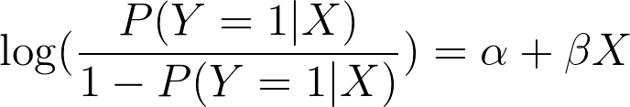
Logistic Regression
Our goal is to fit a linear model to the log-odds of being in one of our classes (in the 2-class case) i.e.

Slide 22
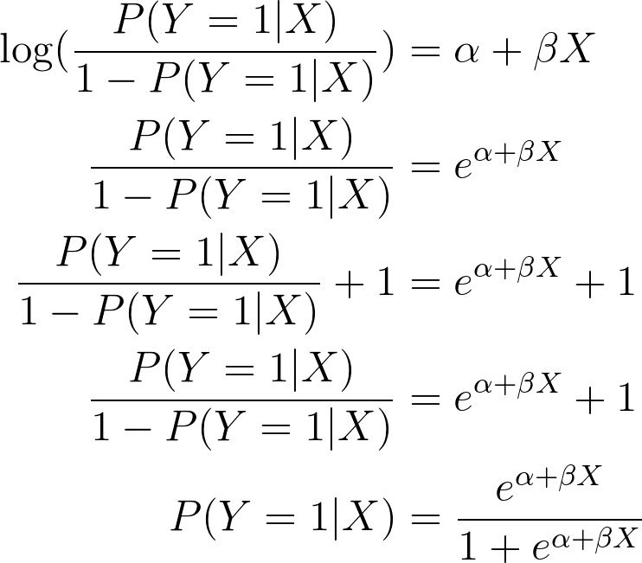
Logistic Regression
Suppose we have such a model. How do we recover the P(Y=1|X)?
The function we apply to our probability to obtain the log odds is called the logit function. The function used to retrieve our probability from the log odds is called logit⁻¹

Slide 23
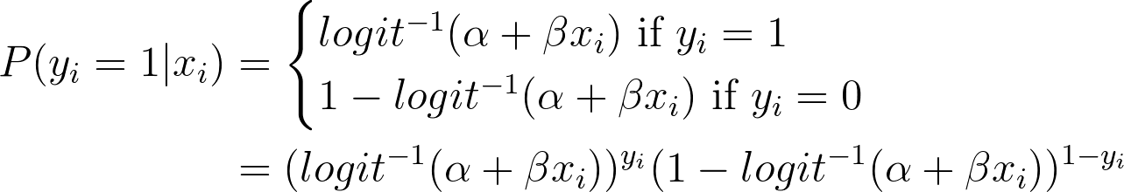
Logistic Regression
How do we learn our model? I.e. the α and 𝜷 parameters.
We know:

Slide 24
Logistic Regression
So we can define
And try to maximize this quantity!
Unfortunately, there is no closed form solution here and we need to use numerical approximation methods to solve this optimization problem

Slide 25
Demo

Slide 26
Evaluating Our Regression Model
Some Notation:
y_{i} is the “true” value from our data set (i.e. x_{i} 𝜷 + ϵ_{i})
ŷ_{i} is the estimate of y_{i} from our model (i.e. x_{i} 𝜷_{LS})
ȳ is the sample mean all y_{i}
y_{i} - ŷ_{i} are the estimates of ϵ_{i} and are referred to as residuals

Slide 27
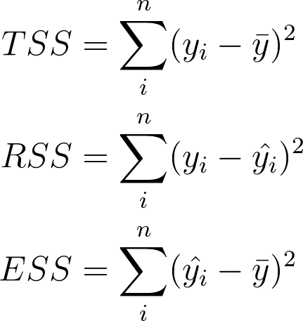
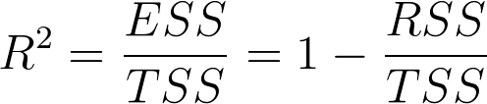
Evaluating Our Regression Model
R² measures the fraction of variance that is explained by ŷ

Slide 28
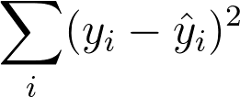
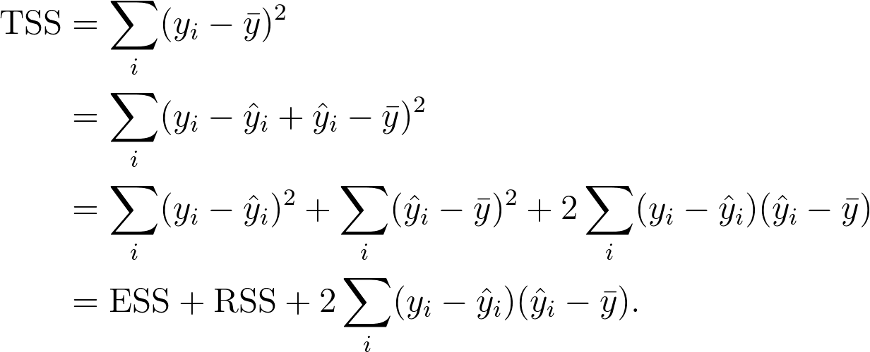
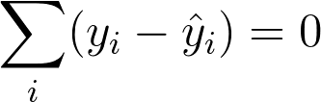
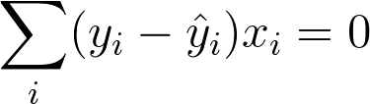
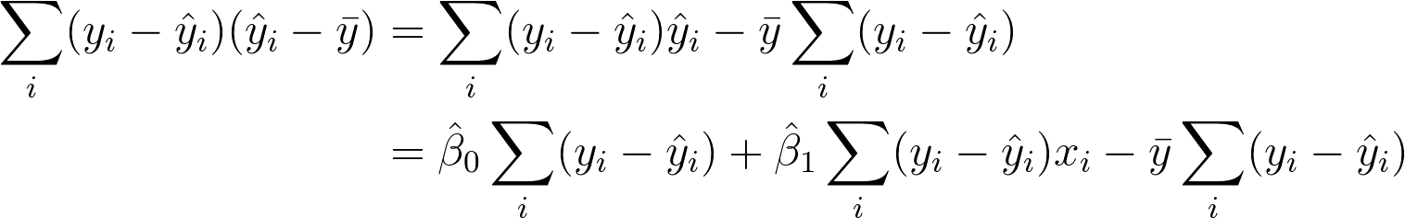
Exercise
Assume for simplicity that ŷ_{i} = 𝜷₀ + 𝜷₁x_{i}
Since 𝜷₀ and 𝜷₁ are least squares estimates, we know they minimize
Show that TSS = ESS + RSS
By taking derivatives of the above with respect to 𝜷₀ and 𝜷₁ we discover that
and

Slide 29
Evaluating our Regression Model
Each parameter of an independent variable x has an associated confidence interval
If the parameter / coefficient is not significantly distinguishable from 0 then we cannot assume that there is a significant linear relationship between that independent variable and the observations y (i.e. if the interval includes 0)

Slide 30
Confidence Intervals
How do we build a confidence interval?
Assume Y_{i} ~ N(5, 25) , for 1 ≤ i ≤ 100 and y_{i} = μ + ϵ where ϵ ~ N(0, 25). Then the Least Squares estimator of μ (μ_{LS}) is
the sample mean ȳ
What is the 95% confidence interval for μ_{LS}?
CI_{.95} = [ȳ - 1.96 x SE(μ_{LS}), ȳ + 1.96 x SE(μ_{LS})]
= [ȳ - 1.96 x .5, ȳ + 1.96 x .5]
SE(μ_{LS}) = σ_{ϵ} / √n
= 5 / √100
= .5
Z-value for 95% Confidence Interval

Slide 31
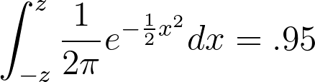
Z-values
These are the number of standard deviations from the mean of a N(0,1) distribution required in order to contain a specific % of values were you to sample a large number of times.
To find the .95 z-value (the number of standard deviations from the mean that contains 95% of values) you need to solve:

Slide 32
QQ plot
We need to check our assumption that our residuals / noise estimates are normally distributed.
How do can you check that a variable follows a specific distribution?
Need to check that our variable is distributed in the same way that a variable following our target distribution would be.
Plot the quantile of your target distribution against the quantiles of your data/ variable! If they match then your data probably comes from that distribution.

Slide 33
QQ plot
Quantiles are the values for which a particular % of values are contained below it.
For example the 50% quantile of a N(0,1) distribution is 0 since 50% of samples would be contained below 0 were you to sample a large number of times.

Slide 34
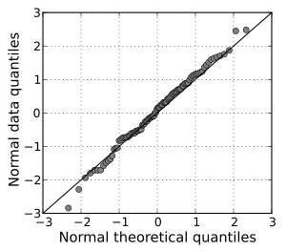
QQ plot

Slide 35
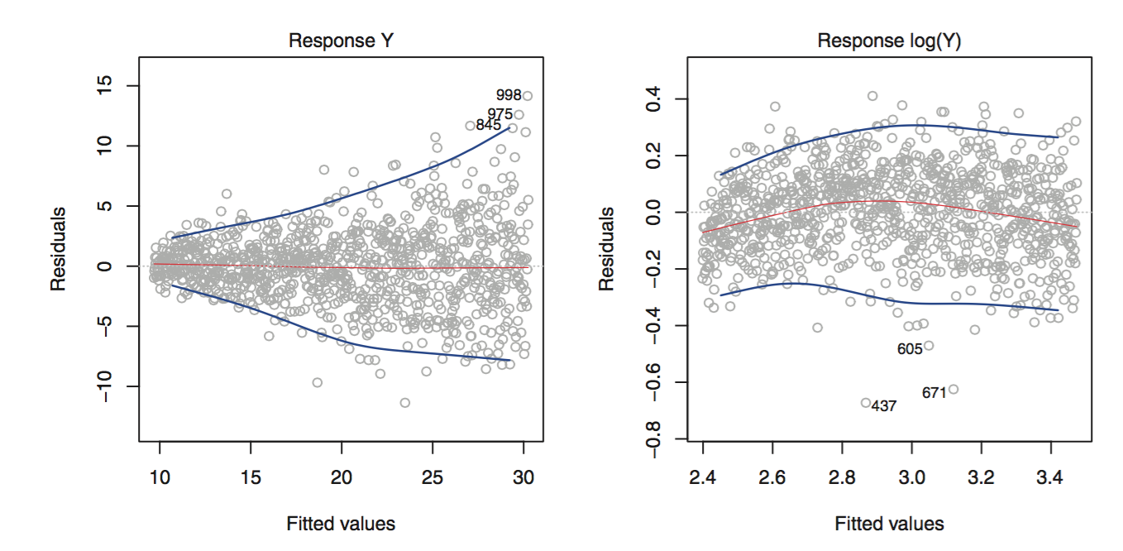
Constant Variance
One of our assumptions was that our noise had constant variance. How can we verify this?
We can plot our fitted values against our residuals (noise estimates)

Slide 36
Extending our Linear Model
Changing the assumptions we made can drastically change the problem we are solving. A few ways to extend the linear model:
Non-constant variance - used in WLS (weighted least squares)
Distribution of error is not Normal - used in GLM (generalized linear models)

